Slide 1

Local Farmers Marketing Platform :-
A Local Farmer marketing Platform is an innovative digital solution designed to bridge the gap between local farmers and consumers, enabling direct access to fresh, local produce. This platform serves as an online marketplace where farmers can showcase their goods, communicate with buyers, and efficiently handle orders and payments. The primary goal of such a platform is to help local farmers reach a broader customer base, reduce intermediaries, and increase their profits while promoting healthy, sustainable eating for consumers, And also our platform empowers small-scale local farmers to connect directly with customers in our community, providing a vital marketplace and support system.
Notes:
1

Slide 2
Empowering Small Farms in Our Community :-
Reduce Overhead
Reach More Customers
Provide Support
Our platform eliminates the need for costly middlemen, allowing farmers to keep more of their hard-earned profits.
We connect farmers to a wide customer base in our local community, expanding their sales opportunities.
We offer educational resources and mentorship to help farmers grow their businesses sustainably.
Notes:
2

Slide 3
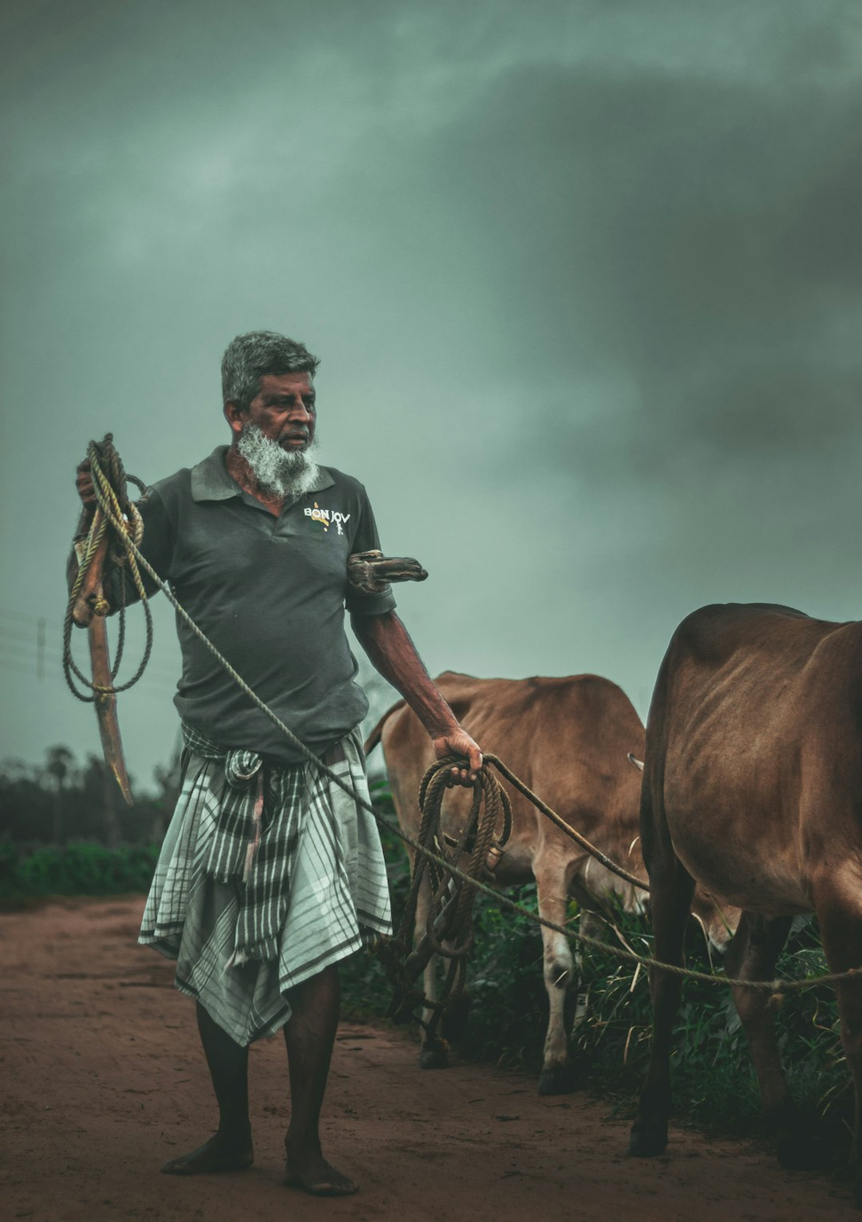
The Challenges Facing Local Farmers
1
Limited Market Access
2
High Operating Costs
Farmers face rising expenses for equipment, labor, and distribution, cutting into their profits.
Small farms often lack the resources and connections to effectively reach potential customers.
3
Unpredictable Weather
4
Lack of Support
Small farmers often struggle to access the resources, information, and mentorship they need to thrive.
Climate change and extreme weather events pose significant risks to crop yields and farm viability.
Notes:
3

Slide 4
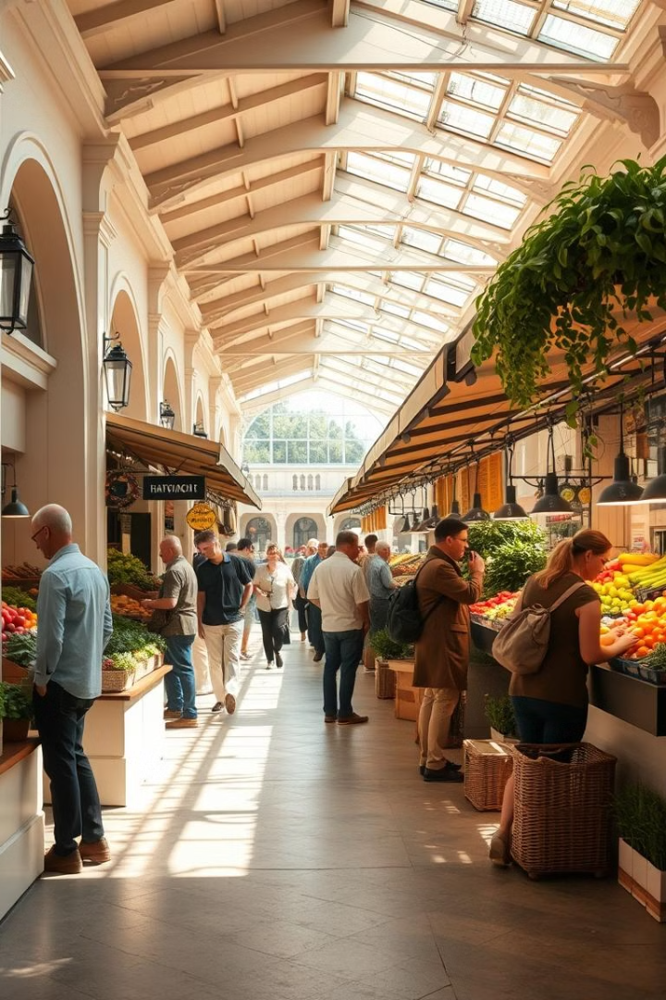
How Our Platform Connects Farmers to Customers
1
Online Marketplace
Our user-friendly platform allows farmers to list and sell their products to customers in the area.
2
Direct Delivery
We facilitate direct delivery from the farm to the customer's doorstep, ensuring freshness and convenience.
3
Community Engagement
We organize local events and workshops to foster connections between farmers and their community.
Notes:
4

Slide 5
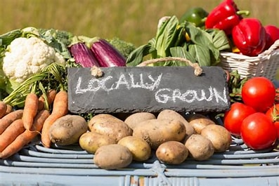
Unique Features of Our Marketplace
Traceability
Seasonal Offerings
Fresh Recipe Suggestions:
Customers can learn about the farm's practices and the journey their food takes to their plate.
Our platform highlights seasonal produce and special items, ensuring freshness and variety.
the platform could include suggested recipes that use the items in the box, helping consumers explore new dishes and creative ways to prepare seasonal foods
Personalized Support
Community Building
Our team provides tailored assistance to farmers, helping them navigate the platform and grow their business.
We foster a sense of community by showcasing local stories and highlighting the impact of supporting small farms.
Notes:
5

Slide 6
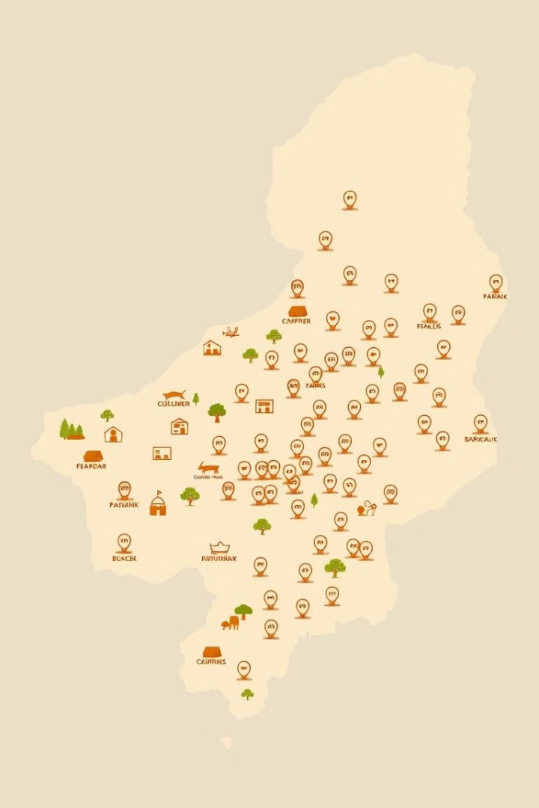



Expanding Our Reach and Impact
Scaling Sustainably
We're carefully expanding our platform to reach more farmers and customers while maintaining our focus on community.
Partnerships
We're building strategic partnerships with local businesses, organizations, and community leaders to amplify our impact.
Knowledge Sharing
We're sharing best practices and insights to inspire other communities to create their own local food systems.
Notes:
6

Slide 7



The Future of Local Food Systems
Resilient Farms
Empowering small farmers to adapt to climate change and build long-term viability.
Accessible Food
Ensuring everyone in our community has access to fresh, nutritious local produce.
Thriving Communities
Fostering strong local economies and vibrant, connected communities centered around food.
Notes:
7

Slide 8
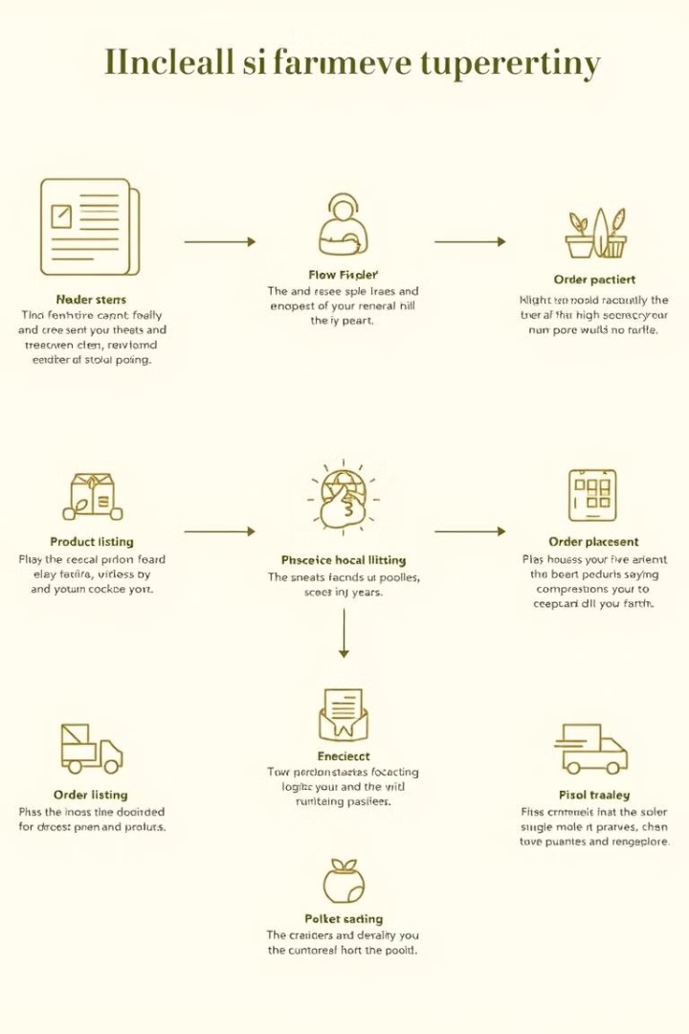
A Streamlined Approach
Farmer Registration
Product Listing
Customer Ordering
Delivery Coordination
Simple onboarding for local farmers to join the platform.
Farmers can easily list their available products and pricing.
Customers can browse and order directly from participating farms.
We facilitate the logistics of getting fresh produce from farm to customer.
Notes:
8

Slide 9
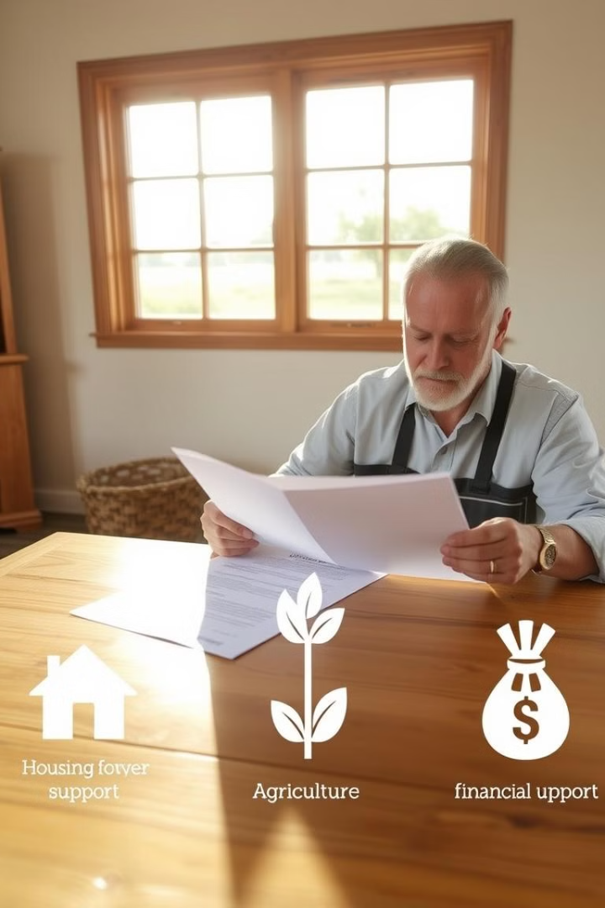
Addressing Farmers' Needs
1
Financial Assistance
2
Educational Workshops
We connect farmers to grants, loans, and other financial resources to help them invest in their operations.
Our platform offers training on topics like marketing, sustainable farming practices, and business management.
3
Advocacy and Networking
We amplify the voices of local farmers and facilitate connections with policymakers and industry leaders.
Notes:
9

Slide 10
Conclusion :-
A local farmer marketing platform provides a significant opportunity to bridge the gap between small-scale farmers and consumers, creating a more sustainable and efficient agricultural market. By fostering direct connections, the platform enables farmers to sell their produce at fair prices while consumers gain access to fresh, locally grown products. This system benefits all parties involved by promoting local economies, reducing supply chain inefficiencies, and supporting environmentally friendly practices. In conclusion, a local farmer marketing platform is an innovative solution that not only enhances the livelihoods of farmers but also promotes healthier, more sustainable food choices for communities.
Notes:
10

Slide 11
thankyou
TEAM MEMEBERS NAME :--
SWAPNIL KUMAR PANDEY (23SCSE1012532)
MINVSESH KUMAR (23SCSE1011111)

